Slide 1

https://github.com/joseph-rickert/useR_2018
Connecting R to the Good Stuff!
Joseph B. Rickert
RStudio R Community Ambassador

Slide 2
The Nature of R
“A key motivation for the original S remains important now: to give easy access to the best computations for understanding data.”
John Chambers: Extending R, CRC Press
The top half John Chambers’ famous diagram from that afternoon in May 1976 indicates their intention to design a software interface so that one could call an arbitrary Fortran subroutine, ABC, by wrapping it in some simplified calling syntax: XABC( )

Slide 3
R
Languages
Python
Stan
C++
Platforms
TensorFlow
Spark
Databases
SQL
DBI
Data Sources
Web
Shiny
DSL
CVX
Tidyverse
NIMBLE
Data Structures
Apache Arrow
Connecting to The
Good Stuff

Slide 4
Reticulate Package: R Interface to Python
reticulate provides a comprehensive set of tools for interoperability between Python and R:
Embeds a Python session within your R session
Call Python from R: using R Markdown by sourcing Python scripts by importing Python modules interactively within an R session.
Translation between R and Python objects (e.g., between R and Pandas data frames, or between R matrices and NumPy arrays).
Bind to different versions of Python including virtual environments and Conda environments.
blog.rstudio.com/2018/03/26/reticulate-r-interface-to-python

Slide 5
Leveraging Reticulate
TensorFlow
Python
Greta
reticulate
XRPython
Commercial solvers
Deep Learning
CVXR
docker
Black – R package
White - Resource

Slide 6

A probabilistic programming language for Bayesian inference and optimization
Code is compiled and run with data
Computes posterior simulations of the model
Uses Hamiltonian Monte Carlo sampler
Run from R with rstan package

Slide 7
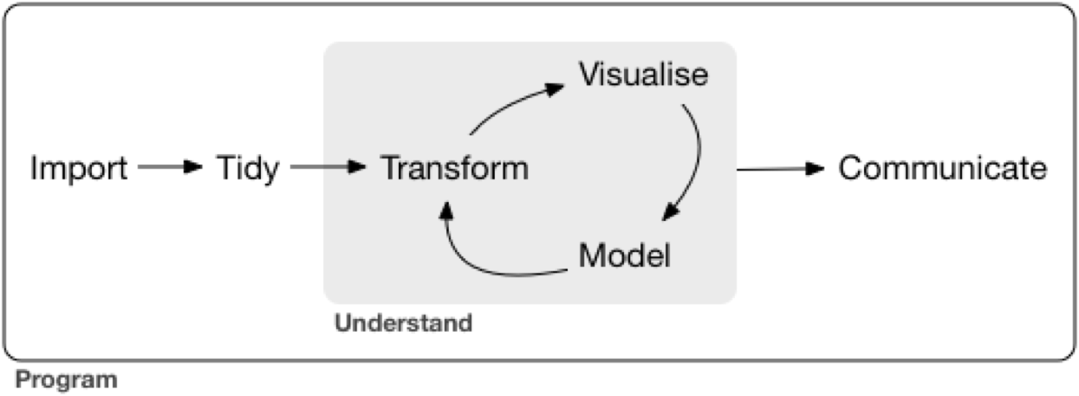
Tidyverse: A DSL for Data science
Expands the reach of R into the Sciences, Engineering, Social Sciences and Humanities.
A coherent system of packages for data manipulation, exploration and visualization
Designed for productivity
Encourages newcomers
Facilitate communication
stemmatoloty package- allows users to explore and analyze the genealogy of textual or musical traditions from their variants,

Slide 8
CVXR: a DSL for convex optimization Problems
CVXR provides an object-oriented modeling language for convex optimization. It allows the user to formulate convex optimization problems in a natural mathematical syntax rather than the restrictive form required by most solvers.
https://cvxr.rbind.io/
https://rviews.rstudio.com/2018/07/09/solver-interfaces-in-cvxr/

Slide 9
NIMBLE Numerical Inference for Statistical Models Using Bayesian and Likelihood Estimation
A DSL for Hierarchical Models
Built on R
Uses BUGs Language
Separates Model from Algorithms
Separates Setup from Model Execution
Compiles R Code
https://rviews.rstudio.com/2018/07/05/a-first-look-at-nimble/

Slide 10
Web Connectivity and Javascript Visualizations
Interactive Web Integration:
Shiny
Web Scraping:
Rcrawler (https://bit.ly/2J8rmhW)
JavaScript Visualizations
r2d3 - R Interface to D3 Visualizations
Htmlwidgets (https://www.htmlwidgets.org/)

Slide 11
Data

Slide 12
DataBase Connectivity
Analyze in database with dplyr
DBI
R's database interface
Implements a common set of methods for data access
Funded by the R Consortium for continuous improvement
MS SQL Server and Access
Oracle
Apache Hive and Impala
Postgress SQL and MariaDB (MySql)
Amazon Redshift
Teradata
Google Bigquery
https://www.r-dbi.org/

Slide 13
Ursa LABS & The Apache Arrow Project
Arrow Memory
R
Impala
HBase
Python
Spark
Cassandra
C++
JavaScript
Language-independent memory structures
Columnar format for flat and hierarchical data
Better performance on CPUs and GPUs

Slide 14
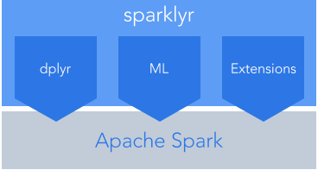
Sparklyr: R interface for Apache Spark
Connect to Spark from R
Dplyr backend
Filter and aggregate Spark datasets
Run Spark’s MLlib models
Create extensions the call the full Spark API
Connect the the Databricks Unified Analytics Platform
Take advantage of parallelism

Slide 15
Tensorflow
Tensors (arrays) flow through a dataflow graph where nodes represent units of computation.
Applications:
Deep Learning
Bayesian Modeling
And More
A general purpose numerical computing library
Developed by the Google Brain Team
Open Source (Apache v2.0 license)
Hardware independent:
CPU (via Eigen and BLAS)
GPU (via CUDA and cuDNN)
TPU (Tensor Processing Unit)
Distributed Execution for large datasets

Slide 16
Deep learning
A machine learning technique for classification and prediction
”Learns” by transforming data through many layers of representations

Slide 17
R Packages for Tensorflow
TensorFlow APIs
keras—Interface for neural networks, with a focus on enabling fast experimentation.
tfestimators— Implementations of common model types such as regressors and classifiers.
tensorflow—Low-level interface to the TensorFlow computational graph.
tfdatasets—Scalable input pipelines for TensorFlow models

Slide 18
Bayesian Modeling
Write statistical models in R and fit them by MCMC on CPUs and GPUs, using Google TensorFlow

Slide 19
Some Links
Code Examples in Repo:
TF_Neural_Net_Keras - uses Keras and TensorFlow to classify MNIST image data
TF_Core_Regression – Implements basic multiple regression model in TensorFlow
R_sparklyr_Spark – Shows how to use sparklyr package to run simple models on Spark
Nimble-ex_v2 – uses NIMBLE to solve Bayesian Hierarchical Model with Pump Data
Stan_logistic_reg – Fits a logistic regression with Stan
Apache Arrow - https://arrow.apache.org/
CVXR - https://cvxr.rbind.io/
Database connectivity - https://db.rstudio.com/databases/
Greta - https://greta-dev.github.io/greta/
NIMBLE - https://r-nimble.org/
Reticulate - https://rstudio.github.io/reticulate/
R2d3 - https://github.com/rstudio/r2d3
Shiny - https://shiny.rstudio.com/
Sparklyr - http://spark.rstudio.com/
TensorFlow - https://tensorflow.rstudio.com/
Ursa Labs - https://ursalabs.org/
For code examples look here: https://github.com/joseph-rickert/useR_2018

Slide 20
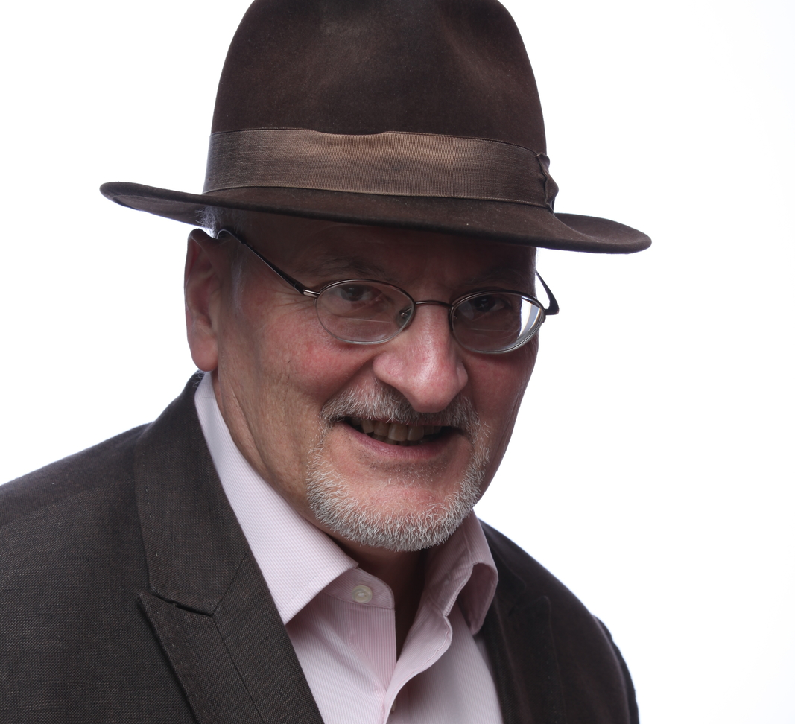
R continues to reinvent itself
Thank you
Joseph.rickert@RStudio.com
@RStudioJoe

